Slide 1
The Price of Air Pollution
Avdovic Lejla, Blasch Fabian, Prinz Martin, Schachinger Maximilian

Slide 2
Overview
The Chinese Healthcare system and its intricacies
The implied relationship between Pollution and Health
Data
Our final W matrix and why there is no perfect W matrix
Updated Pollution and Expenditure Maps
Methodology
Results

Slide 3
The Chinese Healthcare System I
Early 1980s: Opening and globalization of China
From a centralized to an open market economy
Part of Chinas economic reforms: Provinces are responsible for financing and administering the healthcare system.
Hukou System – Resident registration system on household level
Access to social services are based upon the legally registered residence.
Separation into two main groups: Urban and rural
Source of much inequality between cities and the countryside.

Slide 4
The Chinese Healthcare System II
For example
Urban migrant from the countryside
Legal residence in the countryside according to the Hukou system
Medical treatments in the city are paid out of pocket

Slide 5
The Chinese Healthcare System III
Residency and Employment status | Type of Insurance | Services provided for...
Urban employed resident | Urban Employee Basic Medical Insurance Obligatory medical insurance | Stationary and ambulatory treatments are partly covered
Urban resident with no contract of employment (e. g. children, students, disabled people etc.) | Urban Resident Basic Medical Insurance Voluntary medical insurance | Stationary treatments and treatments for chronical diseases
Rural residents | The New Rural Cooperative Medical System (NRCMS) Voluntary medical insurance | Stationary treatments and treatments for chronical diseases

Slide 6
Chinese Air Pollution Policy Changes 2011-2019
Air Pollution regulations were published in:
Air Pollution Control Action Plan (2013)
13th 5-Year Plan (2016-2020)
Renewal of Air Quality Standards (2016)
Content:
Specific pollutant concentration targets to reduce PM-, SO₂-, NO-emissions
Stricter emission standards for vehicles, power plants and industrial facilities and closure or upgrading of old factories

Slide 7
Air Pollution and Health
Between 1.6 and 4.8 million premature deaths due to outdoor Air Pollution in 2010 alone (Lelieveld et al. 2015)
Causal inference of Air Pollution on:
Cardiovascular diseases (e.g. Franklin et al., 2015)
Respiratory diseases (e.g. Kim et al., 2018)
(Lung-)Cancer (e.g. Nyberg et al., 2000)

Slide 8
Data and Variables
Data
Source: National bureau of statistics of China (Online Database)
Yearly data from 31 Chinese provinces from 2011-2019
Variables
Local government expenditure on medical and health care (Yuan) - dependent variable
3 types of air pollution variables (Particulate matter, Sulfur dioxide, Nitrogen oxides)
A couple of socioeconomic and geographical control variables
Share of Population aged 0 – 14, Share of population aged 15 – 65 and share of population older than 65
Disposable Income per capita for rural and urban population
Forest coverage rate
Rural & urban population

Slide 9
Final W Matrix
We considered three different W matrixes for the spatial interaction of our pollution variables
Inverse Distance based
Problematic as the distance must be measured from somewhere, i.e., usually from the centroid, which is problematic if provinces look vastly different. Additionally, depending on wind speed and other conditions it is hard to determine one maximal distance threshold.
KNN Based
Similar problems as with Inverse Distance.
Contiguity based
Allows us to model the structure better for quite heterogenous province sizes and shapes, e. g. Inner Mongolia vs. Tibet.

Slide 11
Methodology I: Model Selection
We ruled out spatial interaction in our dependent variable, because people may not receive state covered healthcare in a province that they do not reside in.
Our testing procedure was therefore the following
We started with the (Spatial) Hausmann Test to test for Random Effects vs. Fixed effects for which the test statistic clearly indicated that fixed effects on a province level are required. Being aware of the quite heterogenous provinces this was not particularly surprising.
Continuing with a Lagrange Multiplier Test (for panels) we tested for the inclusion of a spatial error. But we could not reject the H0 of an OLS model. We therefore continued by constructing a SLX-fixed effects model, where the spatial lags can be directly tested by t-tests.
The Breusch-Pagan Test strongly suggested the absence of homoscedasticity and the Durbin-Watson test for serial correlation suggested serial correlation. To overcome this issue a robust Variance-Covariance-Matrix was employed.
To identify the (final) model a general to specific approach was used.

Slide 12
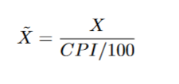
Methodology II: Variable Adjustments
Inflation Adjustment of monetary variables:
Logarithmic transformation was used on all variables except share of population in a age category.

Slide 13
Methodology III: Problems and Limitations
It is unsure how well the robust VCV could handle the problem of heteroscedasticity and serial correlation
At first the idea was to report the Spatial Durbin Error Model as a robustness check.
Unfortunately, no test for serial correlation and heteroscedasticity is developed in R for Fixed Effects models. For Random Effects there are more option, e.g. BSJK test for serial correlation.
This is also the reason we used the LM-test proposed by Anselin for fixed effects, but neglecting the presence of heteroscedasticity and serial correlation in the test
Furthermore, the estimation of a spatial panel of a SDEM in R would not have allowed the correction of heteroscedasticity or serial correlation.

Slide 14
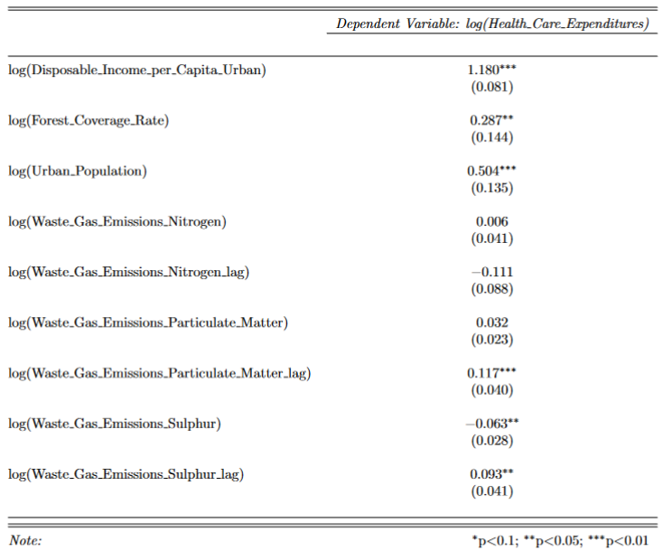
First Results

Slide 15
Sources
Hougaard, J. L., Østerdal, L. P., & Yu, Y. (2011). The Chinese healthcare system. Applied Health Economics and Health Policy, 9(1), 1–13. https://doi.org/10.2165/11531800-000000000-00000
Liu, Z. (2005). Institution and inequality: The hukou system in China. Journal of Comparative Economics, 33(1), 133–157. https://doi.org/10.1016/j.jce.2004.11.001
Nyberg, Fredrik, Per Gustavsson, Lars Järup, Tom Bellander, Niklas Berglind, Robert Jakobsson, and Göran Pershagen. “Urban Air Pollution and Lung Cancer in Stockholm.” Epidemiology 11, no. 5 (2000): 487–95.
Franklin, Barry A., Robert Brook, C. Arden Pope. "Air Pollution and Cardiovascular Disease." Current Problems in Cardiology 40, no. 5 (2015): 207-238.
Kim, Dasom, Zi Chen, Lin-Fou Zhou, Shou-Xiong Huang. "Air pollutants and early origins of respiratory diseases." Chronic Diseases and Translational Medicine 4, no. 2 (2018): 75-94.
Lelieveld, J.; J. S. Evans, M. Fnais, D. Giannadaki, A. Pozzer. "The contribution of outdoor air pollution sources to premature mortality on a global scale." Nature 525 (2015): 367-371.

